Slide 1
The Business of State Coalitions

Slide 2
You’re Running a Business!
Operations
Marketing
Compliance
Profitability

Slide 4
Bylaws / Affiliation Agreements Conflict of Interest Policies 990’s State and Local Filings Money Matters
Organizational Essentials

Slide 5
Bylaws
State laws may have various requirements such as how many board members the board must have and other specifics. These are bases that must be covered.
Bylaws should include the most fundamental rules only. Boards can make amendments to the bylaws as needed. Things that are apt to change are better written as policies.
Nonprofits must have a dissolution clause in the bylaws according to legal requirements. Because nonprofits are required to re-invest monies back into their charities to maintain tax-exempt status, if the organization ever dissolves, there are specific rules for how they can distribute their assets.

Slide 6
Bylaws (cont.)
Bylaws are the main governance documents for the organization. Directors should also be aware of their legal duties and responsibilities and that they can be held personally liable for not following the bylaws.
The bylaws serve as a sort of handbook for nonprofit board directors. The bylaws outline how the organization will be run and serve as a guide for the board as they take actions and make decisions. When questions arise, the bylaws can be extremely helpful in preventing or resolving disagreements.
Nonprofit organizations should review their bylaws at least every two years to ensure that the information they are putting on IRS Form 990 is accurate.

Slide 7
Conflict of Interest Policy
A policy on conflicts of interest should (a) require those with a conflict
(or who think they may have a conflict) to disclose the conflict / potential conflict, and (b) prohibit interested board members from voting on any matter in which there is a conflict.
Beyond including those two basic directives, each nonprofit needs to determine how the board will manage the conflict.
Keep in mind that the IRS Form 990 asks not only about whether the nonprofit has a written policy on conflicts of interest, but also about the process that the nonprofit uses to manage conflicts, as well as how the nonprofit determines whether board members have conflicting interests.
Some state laws governing nonprofit corporations include provisions describing what must be included in a nonprofit's conflict of interest policy.

Slide 8
990’s
Most tax-exempt organizations are required to file an annual return. Which form an organization must file generally depends on its financial activity, as indicated in the chart below.
The Pension Protection Act of 2006 added a new law that provides for automatic revocation of an organization's tax-exempt status if it fails to file a required annual information return for three consecutive years.
Gross receipts normally ≤ $50,000 Note: Organizations eligible to file the e-Postcard may choose to file a full return | 990-N | User Guide for Form 990-N PDF
Gross receipts < $200,000, and Total assets < $500,000 | 990-EZ PDF or 990 PDF | Instructions PDF
Gross receipts ≥ $200,000, or Total assets ≥ $500,000 | 990 PDF | Instructions PDF
Private foundation - regardless of financial status | 990-PF PDF | Instructions PDF

Slide 9
State Laws and Local Filings
Each state’s law is slightly different, but most require nonprofit corporations to periodically confirm or update their basic contact information, such as mailing address, the name(s) of responsible parties, and registered agent. State Coalitions should review their state laws in these areas:
Bylaws and Conflict of Interest
Document Retention Requirements
Gaming Laws (such as raffles)
Nonprofit Audit Requirements by State Law
State Agencies Governing Nonprofits by State
Filing requirements by state

Slide 10
Money Matters
If we are promoting sound money management to students, your coalition needs to walk the talk.
Are your bank documents (signature authority, etc.) up to date?
Are you retaining financial documents and protecting the organization’s information?
Do you have a revenue goals and a budget?
Are your 990’s and other filings up to date?

Slide 11
Independent Financial Audits Liability Insurance Document Retention Can-Spam Photo Releases Lobbying and Campaigning
Organizational Protections

Slide 12
Independent Financial Audits
An independent audit is an examination of the financial records, accounts, business transactions, accounting practices, and internal controls of a charitable nonprofit by an "independent" auditor.
"Independent" refers to the fact that the auditor / CPA is not an employee of the nonprofits but instead is retained through a contract for services, and hence is “independent.”

Slide 13
Independent Financial Audits (cont.)
Not all charitable nonprofits are required to conduct an independent audit. Circumstances that may trigger the requirement for an independent audit such as:
Federal, state, and local governments may request a copy of the organization's audited financial statements.
Nonprofits that expend $750,000 or more in federal funds in a year are subject to special audit requirements.
Some contracts with state and local governments to provide services in the community may require the nonprofit to conduct an independent audit.
Many state laws require that nonprofits submit a copy of their audited financial statements when they register with the state for charitable solicitation or fundraising purposes.
Private foundations may request that a nonprofit submit a copy of the nonprofit’s most recent audited financial statements in conjunction with submitting a grant proposal.
Some banks may require a nonprofit to have an audit as a condition of receiving a loan.

Slide 14
Liability Insurance
General Liability Insurance
General liability insurance protects against lawsuits that arise from accidents involving visitors, constituents, or delivery people. If you hold a fundraiser or other special event, you might need this coverage to book a venue or fulfill a vendor contract.
Directors & Officers (D&O) Insurance
Nonprofit Directors & Officers (D&O) Liability insurance helps cover the defense costs, settlements and judgments arising out of lawsuits and wrongful act allegations brought against a nonprofit organization.
An Overview Document of Both Coverages is Available in the State Leaders Toolkit

Slide 15
Document Retention Policy
Document retention policies apply equally to documents saved in the cloud, on a server, or in a filing cabinet. If your coalition is using digital storage, make sure you have a back-up plan!
While having a document retention policy gives staff the green light to toss certain documents (on a schedule, preferably), as you are creating a policy specifically for your state coalition, think about whether there are certain types of documents or specific documents that for the sake of history, or institutional memory, should be maintained permanently.
State laws relating to employment vary state to state and often have implications for document retention policies.
Check with the professional advisor / accounting firm that prepares your nonprofit's annual returns to the IRS and ask what documents may be needed in the event of an IRS audit, and how long to retain them.
Another source for state requirements is your local state association of nonprofits. They may offer a state-specific sample document retention policy as a member-only resource.

Slide 16
Can-Spam
The Controlling the Assault of Non-Solicited Pornography And Marketing Act of 2003, signed into law by President George W. Bush on December 16, 2003, established the United States' first national standards for the sending of commercial e-mail and requires the Federal Trade Commission to enforce its provisions.
General Practices
Don't use false or misleading header information.
Don't use deceptive subject lines.
Identify the message as a solicitation.
Tell recipients where you are located.
Tell recipients how to opt out of receiving future email from you.
Honor opt-out requests promptly.
Unified Marketing Platforms like Mailchimp or Constant Contact are good sources to provide guidance and protection from “can-spam”.

Slide 17
Photo Releases
To err on the side of caution, the state coalition should get permission to photograph and use photos of any subject for both legal and ethical reasons. This whole issue of “model releases” falls into a gray area of First Amendment law. There are no hard and fast rules — every answer to a model release question is subject to any number of caveats
If you are publishing a photo for information or educational purposes, not commercial purposes like product advertising, you can typically print it without a model release. The majority of nonprofit publications fall into this category. Model releases are all about the use of the photo, not the fact that it was taken.
You are also fine without a release if the person is truly unrecognizable. You are usually fine if you are not hiding the fact that you are taking photos and you are in a public place and are not breaking any laws.

Slide 18
Photo Releases (cont.)
If you make participants sign other kinds of applications or waivers, simply add this language to those forms. Prior to the age of social media, big events like conferences were considered public and since there was no expectation of privacy, a release was generally not required from the hundreds of people at the event. A good practice now is to include the release as part of your registration form or ask people to sign it when they pick up their registration materials.
The only place where release is required without question, is in the case of children under 18. A signed release must be obtained by the guardian for children under 18.
When children are involved, you enter a whole new realm of law and best practices.

Slide 19
Lobbying and Campaigning
Campaigning
Under the Internal Revenue Code, all section 501(c)(3) organizations are absolutely prohibited from directly or indirectly participating in, or intervening in, any political campaign on behalf of (or in opposition to) any candidate for elective public office.
Lobbying
In general, according to the IRS, "no organization may qualify for section 501(c)(3) status if a substantial part of its activities is attempting to influence legislation” (commonly known as lobbying). Section 501(c)3 allows for lobbying, provided the lobbying is not a substantial part of a nonprofit’s overall activities. The limitations established under this rule are ambiguous, creating a level of uncertainty for those relying on it.
Example: Because direct lobbying both refers to specific legislation and reflects a view on it, sending a paper to a state legislator on a general issue that does not reflect a view on specific legislation is not a direct lobbying communication. Telling your members or partners the coalition’s position on legislation and asking them to contact their legislators about it IS direct lobbying.

Slide 20
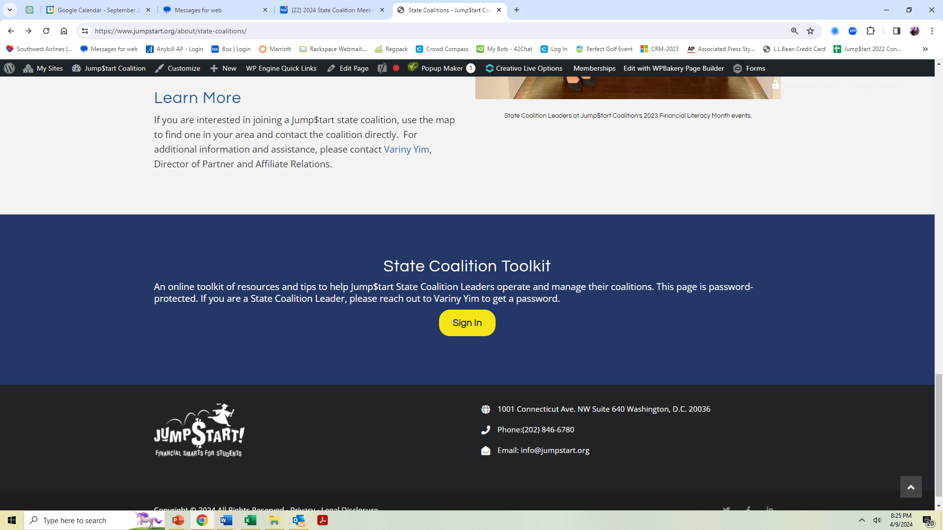
Refer to the State Leaders’ Toolkit

Slide 21
