Slide 1

Financial Literacy Month
April 2025
Student Names________
School_______________
Class________________

Slide 2
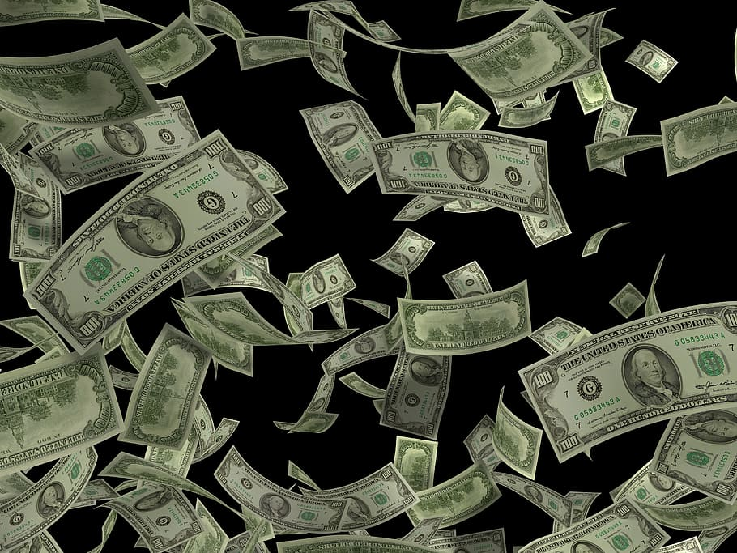
Question of the Day!
Would you rather…
We give you $1 Million
or
Give you a penny and double
it everyday for 30 days?

Slide 3
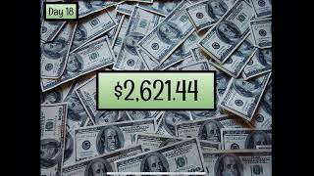
Let’s check it out

Slide 4
Grade 4: Investing in Tomorrow
Introduce yourselves. Include your grade and a little bit about you.
Explain that you are taking a class called Consumer Economics and in it you learn ways to be a better consumer/shopper and a lot of lessons about becoming an adult. Because you are almost out of high school, it’s very important to learn life lessons.
Today we want to share a lesson on Investing in tomorrow. We will use a modern version of an old Aesop’s Fable to help you see the importance of your decisions and of the value of saving. We will share where you can save your money in Sauk Prairie and give you tips on how to build your wealth in the future.
Students will ADD their personal slide about themselves with pictures and info about them

Slide 5
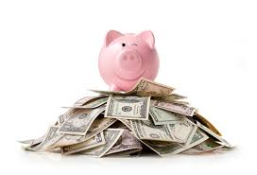

Vocabulary
$ OPPORTUNITY COST
$ SAVING
$ AUTOMATED TELLER MACHINE (ATM)
$ INVESTING
$ COMPOUND INTEREST

Slide 6
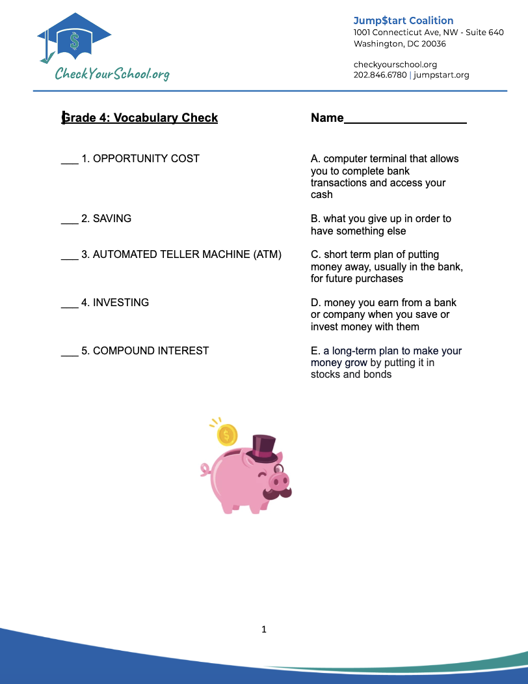
In Class Activity
Notes:
worksheet document: https://docs.google.com/document/d/1jEmX4QehMZQDRjEK6cmJHm9291NvhaB_qZ4Eombvmbc/edit

Slide 7
A Deeper look at: Opportunity Cost
*EVERY CHOICE YOU MAKE HAS CONSEQUENCES*
Choice Play soccer during recess | Opportunity Cost The chance to play basketball
If I use my time to watch television | Studying for my math test
If I buy a video game | The snack that I would otherwise have purchased with same amount of money
If I spend all my money now | I may not have the money I need in the future to go to college, buy a house or save a million dollars

Slide 8
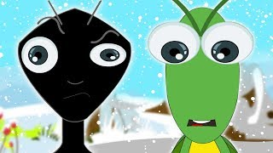
Here is the classic Aesop’s Fable
“The Ant and the Grasshopper”
What is a FABLE?
A fable is a short story, often with animals as characters
It’s intended to teach a moral or lesson about life.
Fables are found worldwide and for centuries they have been handed down from one generation to another.
Be sure to listen to the moral at the end of the story!

Slide 9
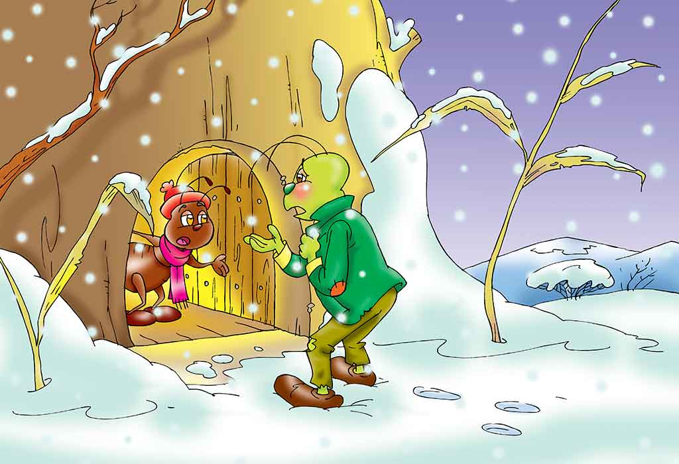
What was moral to the fable?
You must work hard and make the right choices to provide for your future.
How does this story relate to the financial choices you have to make today?
The money we earn and save and the choices we make now can help us to have the money we need in the future.
Let’s look at a modern “financial” version of this classic fable…

Slide 10
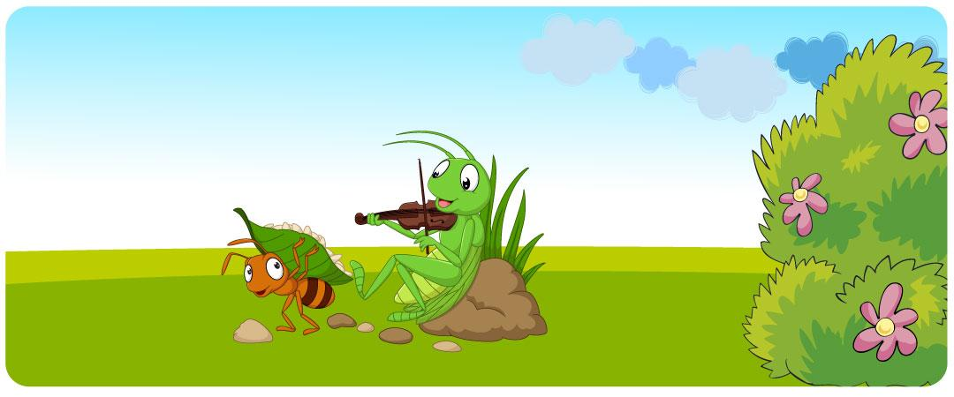
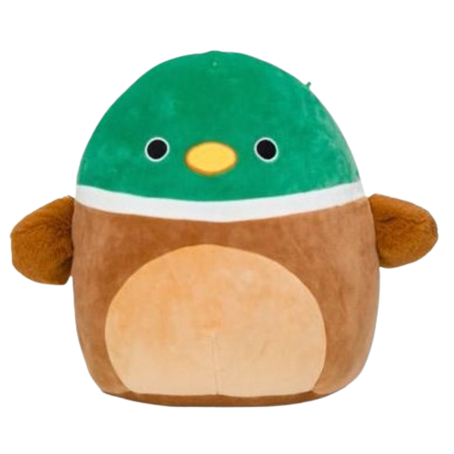
The Ant and the Grasshopper
Making the Right Choices to save for Your Financial Future!

Slide 11
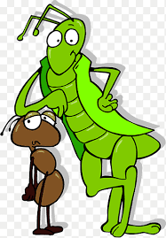
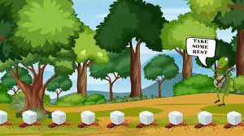
The Grasshopper and the Ant: A Fable About Saving
One wondrously sunny day just before the beginning of the new school year, Sam, a very unhappy grasshopper, was frolicking through the neighborhood. He came upon some ants that were busily carrying pennies, nickels, and dimes to the corner bank. It looked like backbreaking work, each ant carrying a load 10 times its own size. “Wow!” said Sam, as he stopped to see if he had enough money to play the claw machine, “Why would anybody spend such a great day working so hard?”

Slide 12
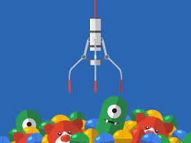
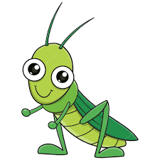
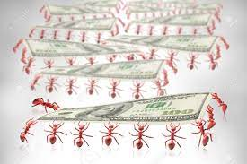
As he watched the industrious ants, he reached deep into his pocket to pull out his last shiny quarter. He dropped it in the slot and continued his daily quest for the rarest stuffed squishmallow. Squishmallows were Sam’s passion. Sometimes he played the claw machine three times a day in hopes of taking one home.
“Rats!” he exclaimed as the claw rose again… empty. “Where can I get another quarter? I bet I can borrow one from Sandra, the ant. She’s just putting it in the bank and doesn’t need it. “Hey Sandra, old buddy, can I borrow 25 cents? I’ll pay you back next week.”

Slide 13
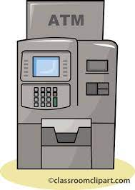
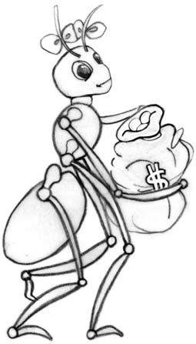
“Where did all your money go?” asked Sandra as she deposited more money into the Automatic Teller Machine. “You seem to always spend your money on fun and games. Why should I think that you can save your money to repay me next week? Have you saved any money you earned this summer?”
“Hey, I’ve had the greatest summer ever! I didn’t work much, went to the amusement park six times, played the claw machine every day, and stuffed myself with candy all summer. You guys work too hard and don’t have much fun. I’m too young to worry about saving money. I get whatever I want. That’s what being a kid is all about. What’s so great about saving anyway? It just means you can’t have the things you want now.”
“I’m saving” Sandra said, “so that I can buy some great new school clothes, have enough money for a fun holiday vacation, and do things on the weekend during the winter when I don’t have time to work and earn money. And I can tell you another thing that is really great about saving—INTEREST.”

Slide 14

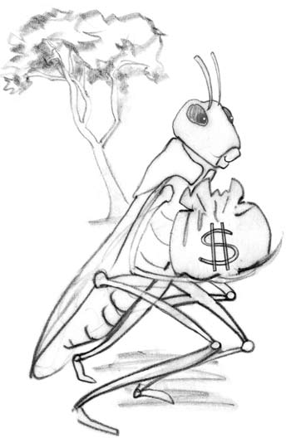
“Wait a minute,” said Sam. “You think it’s interesting to put money in the ATM machine?
Well, that may be what interests you, but it doesn’t interest me. Having fun interests me, buying stuff interests me, going to the movies with my friends interests me.”
“You don’t seem to care much about the future,” said Sandra. “Have you ever thought about saving for college? By the way, I didn’t mean that saving interests me. I meant that I earn interest from the bank when I save.”
“Are you nuts?” asked the grasshopper. “I’m too young to save!” he added. “Oh, of course, the bankers are interested in your money. Why wouldn’t they be? They get to keep it and use it and you can’t spend it.”

Slide 15


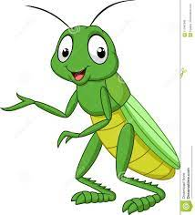



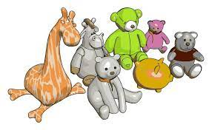
“Don’t you think about all the other things that you could do with the money you spend?” asked the ant. “Do you buy the first thing you see, or do you think about what you give up? And, for your information, I didn’t say the bank was interested. I said the bank PAYS interest to me.”
“You don’t know what you’re talking about. When I buy stuff, I’m not giving up anything. I’m getting things,” replied the grasshopper. “I don’t think you know what you’re talking about with that interest stuff either. Maybe you better look that word up in the dictionary.”

Slide 16

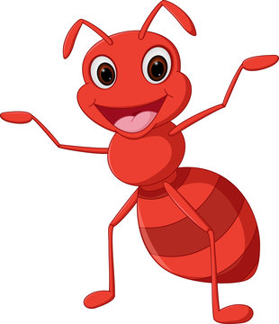
“When you buy things, you are giving things up,” said Sandra. “When you spend a dollar, you don’t have that dollar for something else. When you spend a dollar, you don’t have it for something you might want in the future. Every choice you make has an opportunity cost. When I save, I know that I’m giving up something that I could have today for something in the future. I also know that when I save the bank pays me interest. I don’t have to look that word up in the dictionary because I know exactly what it means. The bank pays me extra money to keep my savings in a bank account. That means I’m getting paid for saving. That’s what interest is. Maybe you better visit a bank and learn something besides how to put quarters into claw machines. I can’t chat anymore. I have work to do,” said the ant.

Slide 17

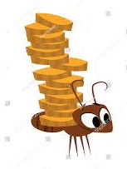
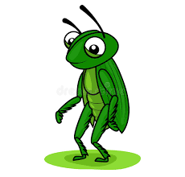
As the ant walked away, Sam could be heard mumbling. “Sure, the bank pays you for saving. Ha! And grasshoppers turn into butterflies. Opportunity cost, what’s that all about?”
A few months later, Sam was walking through the neighborhood again when he spotted the ant making another trip to the bank. “Hey, Sandra, what are you doing now?”
“I’m withdrawing some of my savings—to go to the movies with my friends this weekend,” she replied. “What are you doing?”

Slide 18



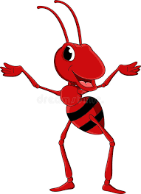
“Nothing, I guess,” the grasshopper said, longingly eyeing the video game that he couldn’t afford to play. “I don’t have much fun these days. Now I think I know what you meant about opportunity lost.”
“You mean opportunity cost?” asked the ant.
“Yeah, that’s it. I guess I got the term wrong. I was hoping that you could tell me some more about saving and interest, too. You talked about those ideas the last time we were together, but I really
didn’t understand.”

Slide 19
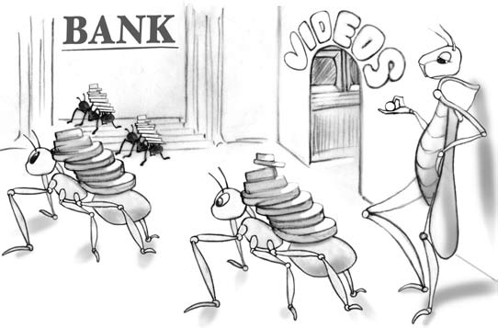
“Well, you were close. When you give something up, it is like losing an opportunity,” said the ant. “I’d be happy to help you learn about
saving and interest. Keep in mind that if you only play for today, you
may have nothing for tomorrow.”
The moral of this story is…
If you do nothing but play today, you may have nothing left for tomorrow

Slide 20
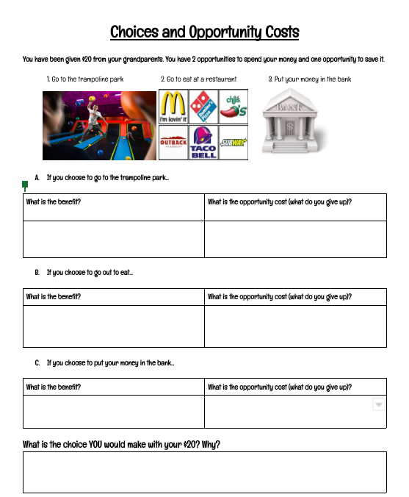
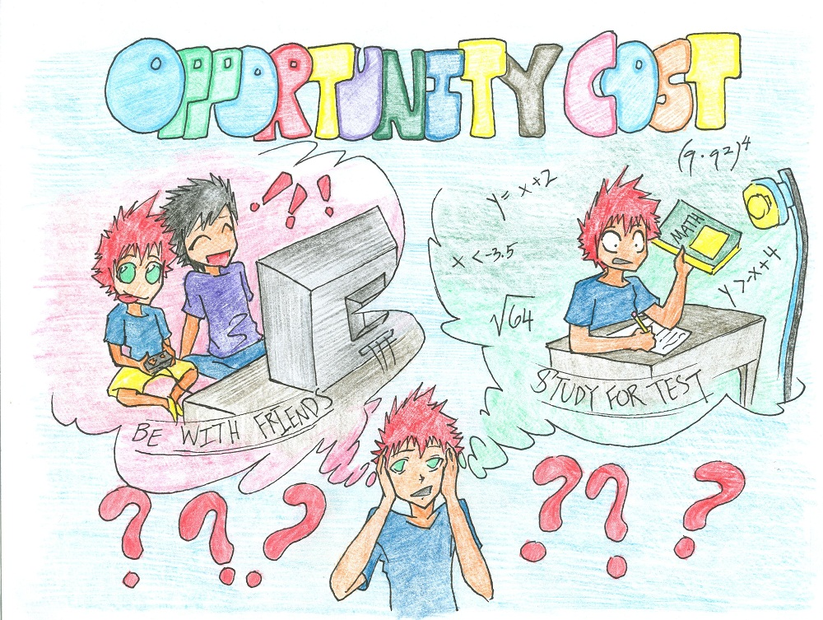
How can I plan for my financial future?
#1. We need to make smart decisions
In Class Activity
Remember every choice has a consequence…
An OPPORTUNITY COST!

Slide 21





How can I plan for my financial future?
#2. Open a savings account at one of our local banks
Why?
A safe place to keep your money where you will earn interest on your account.
You can keep your money for future purchases you want to make
Eventually you can open a checking account and get a debit card to be able to access your money
Local Banks in our Community
Heritage Credit Union

Slide 22
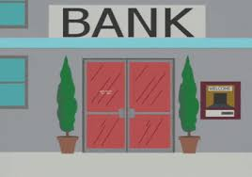
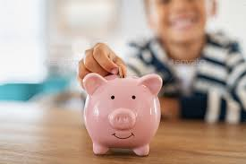

How do you open a savings account?
You need to have a parent or guardian with you.
You and your parent can open an account by visiting the bank that you chose.
When you open your account it’s important to try and regularly put money into the account.
Birthday money, allowance, money from jobs – all are examples of money you can use to help your savings account grow.
By regularly putting money in your savings account and earning interest, you can achieve your goals to save to get items you would like to have.

Slide 23
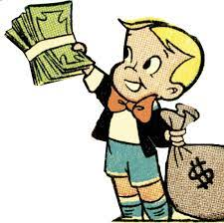

How can I plan for my financial future?
#3. Investing to create wealth for your future
Investing involves leaving your money alone to grow over time. You will need to look at a different type of plan than a savings account.
Remember the Question of the Day we started class with? Though this situation was hypothetical, you, as a saver/investor have an opportunity to grow your wealth over your lifetime.
Can you get rich quick? No and if we knew how, we might be on a warm beach someplace!
The KEY is COMPOUND INTEREST

Slide 24

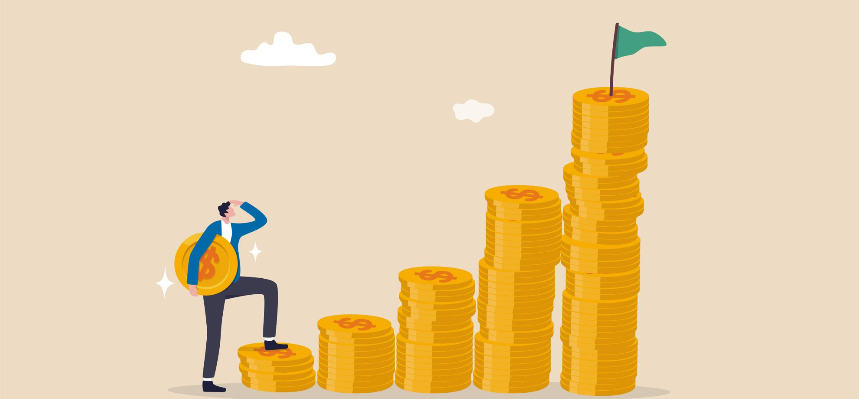
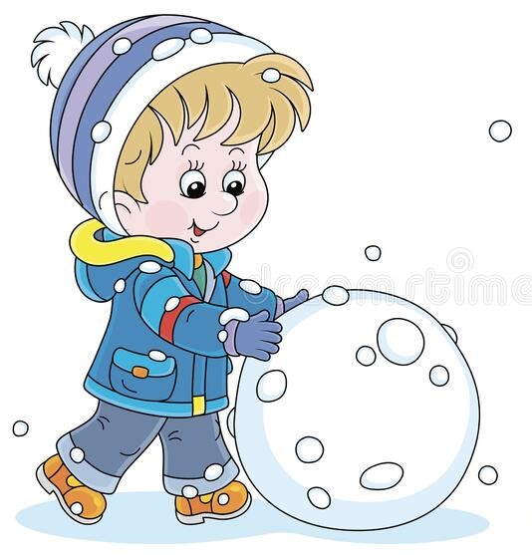
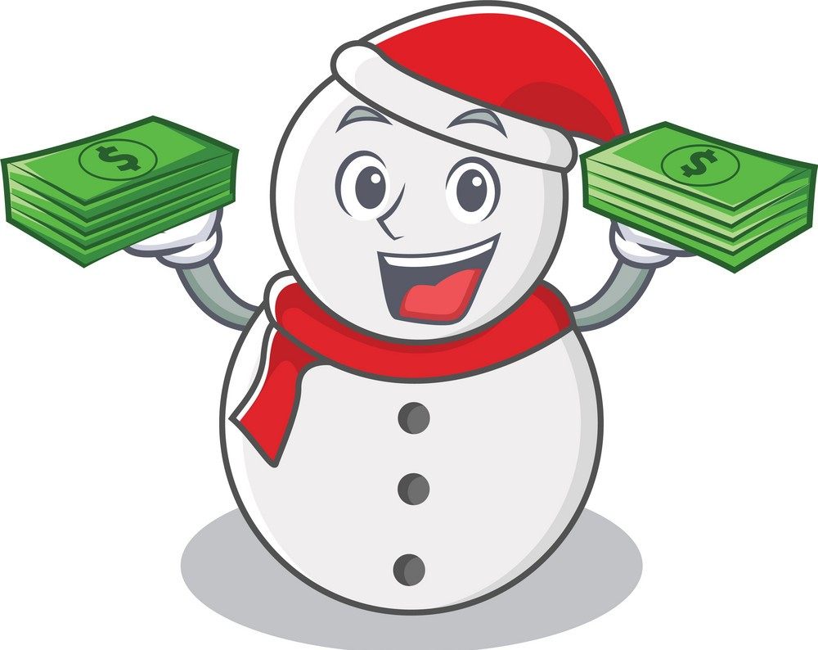
COMPOUND INTEREST
Compound Interest works a lot like when you are rolling a snowball to make a snowman.
You put money away in a savings or investment plan and a bank or company pays you interest. Then you can put in more money and make even more interest. It grows and grows and grows over time just like rolling that snowball.
Monthly Contribution | Balance When You Turn 18 | Balance When You Turn 25
$5 | $2,158 | $4,333
$10 | $4,318 | $8,666
$25 | $10,795 | $21,666
$50 | $21,589 | $43,332
$100 | $43,179 | $86,664
$250 | $107,949 | $216,661
These examples are hypothetical and assume an 8% annual return

Slide 25
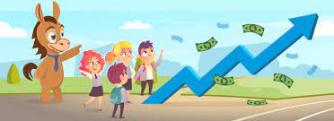
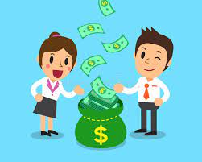
How can I plan for my financial future?
#3. Investing to create wealth for your future (cont.)
But, it IS POSSIBLE for you to grow your wealth overtime and have the money you need and want to live a comfortable life in the future. Creating a fund for college or your retirement may seem a long way off but starting now can make it a reality.
The options below may sound confusing, but we will share this information with your parents so you can begin the discussion of the saving and investing plan that would work best for you.
Custodial Roth IRA
Uniform Gift to Minors (UGM) Act and Uniform Transfer to Minors (UTM) Act
529 Plan ( EdVest in Wisconsin)

Slide 26
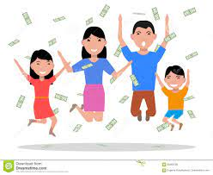
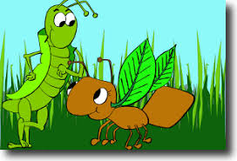

THANK YOU!!!
We would like to thank you for allowing us the opportunity to share this lesson about Investing in Tomorrow. We hope you found the information interesting and helpful. Understanding that you, your parents and all consumers have choices to make that come with opportunity costs is key. Planning for savings for the short term and investing for the long term will put you in great financial shape for your future. Please talk with your parents and see which one plans may work best for you.
Thanks again for your attention and have a great rest of the school year.

