Slide 1

Financial Literacy Month
April 2025
Student Names________
School_______________
Class________________

Slide 2
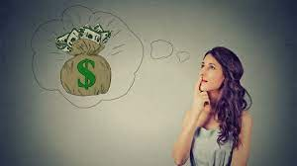
Grade 2: Making Financial Choices and Opportunity Costs

Slide 3
Introduce yourselves. Include your grade and a little bit about you.
Explain that you are taking a financial literacy class and in it you learn ways to be a better consumer/shopper and a lot of lessons about becoming an adult. Because you are almost out of high school, it’s very important to learn life lessons.
There are also lessons that are important for you as elementary students to learn. This can get you a head start to be smart about the choices you make with your money.

Slide 4
Presenter 1:
Info about you

Slide 5
Presenter 2:
Info about you

Slide 6
Today we’re going to be talking about making good financial choices.
How many of you have had your own money to spend?
Was the money an allowance or a gift, like money given in your birthday card?
We are going to read a book about a boy who had some money, but didn’t spend it wisely.
It’s called Alexander, Who Used to Be Rich Last Sunday, and it was written by Judith Viorst. Let’s see what happens to Alexander in this story.

Slide 7
Questions about the story…
How rich was Alexander last Sunday?
Alexander’s grandparents gave him a dollar. Write $1.00 on the chart paper or chalkboard, leaving plenty of room to continue a multi-step subtraction problem as the story is discussed.
What did Alexander plan to do with his dollar?
He planned to save his money to buy a walkie-talkie (ninth page of the story).
Did Alexander save his dollar?
No.
What did he do first?
He went to the drug store and bought bubble gum. Reread the tenth page aloud, slowly. Ask students:
How many pieces of bubble gum did Alexander buy?
Three pieces.
What did it cost?
Fifteen cents. Write 0.15 below the $1.00 on the chart paper and subtract it for the class.
How much does Alexander have left?
Eighty-five cents.

Slide 8
Questions about the story (cont.)
What did Alexander bet his family?
He bet Anthony that he could hold his breath until he counted to 300. He bet Nicky that he could jump from the stoop and land on his feet. He bet his mom that she couldn’t guess which hand his purple marble was hidden in.
Did he win?
No.
How much did he lose this time?
Fifteen cents. Subtract this on the chart.
How much does Alexander have left?
Seventy cents. Continue naming Alexander’s money losses, subtracting them from the total, and allowing the class to keep track of the remainder:
• Rent Eddie’s snake for an hour: Twelve cents. Alexander’s total: 58 cents.
• Using a bad word when each of his brothers teased him: A dime (10 cents). Alexander’s total: 48 cents.
• Flushed down the toilet: 3 cents. Lost in the crack: 5 cents. Total: 40 cents.
• Pay for Anthony’s chocolate bar after he ate it: 11 cents. Total: 29 cents.
• Lost in Nick’s magic trick: 4 cents. Total: 25 cents.
• Kicking something when his brothers teased him: 5 cents. Total: 20 cents.
• Bought three things at a yard sale: 20 cents. Total: zero.
Alexander tried to earn more money. What were some of the things he tried?
• Make a tooth fall out
• Looked in phone booths
• Cash in non-refundable bottles (You may need to explain this obsolete custom to the students.)
• NOTE: In an illustration we also see Alexander printing a sign to try to rent his toys. It isn’t mentioned in the story, but some students may have noticed it.
Do you think Alexander used his money wisely? What should he have done?
Hopefully your students will mention that Alexander should have thought about his purchases more carefully, should have remembered the walkie-talkie that he really wanted, or should have taken better care of his money.
If not, don’t bring it up now. The activities in the rest of the lesson should make the point.

Slide 9
Today’s Economic Concepts:
WANTS, OPPORTUNITY COSTS, and FINANCIAL DECISION MAKING
Alexander really wanted a walkie-talkie. He also wanted some gum, some chocolate, and some items at a garage sale. He wanted to rent his friend’s snake, and he wanted to make bets with his family. All of these things are called wants—the things you want that you have to give something up for. What did Alexander give up?
Money.
Sometimes we give up things other than money. Let’s say you’re invited to a birthday party and a baseball game next Saturday. You can’t go to both of them; they’re at the same time. Which would you choose?
Allow students to declare their preferences.
The thing you don’t go to is what you gave up. This is the opportunity cost. If you chose the birthday party, you could say that going to the party cost you a baseball game. Did Alexander have enough money to do and buy all of his economic wants?
No.
Nobody ever has enough money to buy and do everything they want. I don’t have enough money, your parents don’t, your teacher doesn’t, and even the President of the United States doesn’t have enough money to do and buy everything. That’s why it’s important to decide what you want the most. Did Alexander stop and think about what he wanted the most? No, he spent his money as soon as he thought of something he wanted right then. He didn’t plan for the future, and he didn’t think. That meant he gave up the walkie-talkie, the thing he really wanted the most. The walkee talkee was his opportunity cost. When he was careless with his money, it cost him the walkie-talkie.

Slide 10
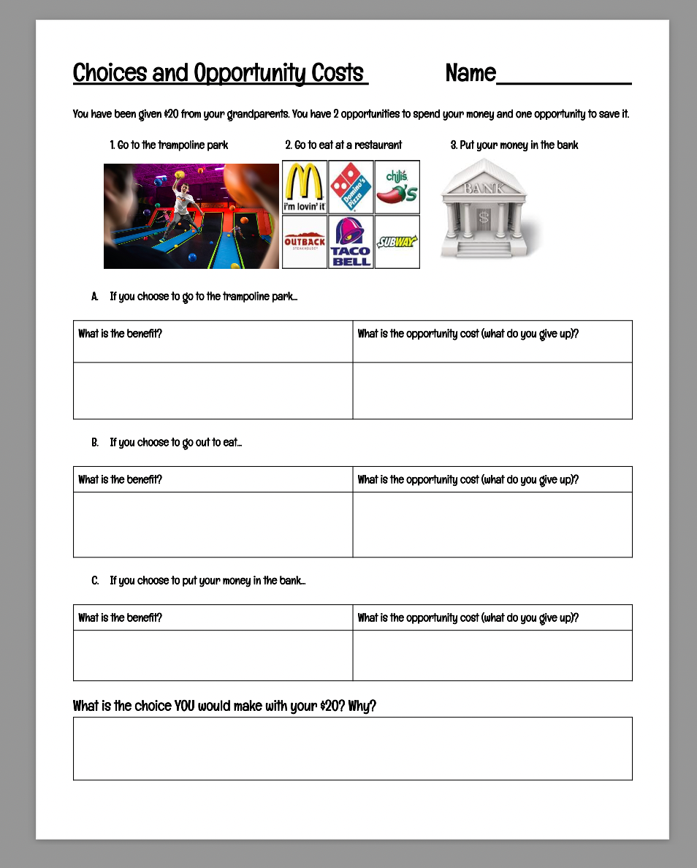
Choices and Opportunity Cost Activity

Slide 11
Concluding the Lesson
It’s time for us to head back to the high school, but we would like to thank you for welcoming us into your classroom today. We hope that you have enjoyed the lesson we have presented about making good CHOICES with your money.
It is great to be able to buy the things we WANT, but always remember there are OPPORTUNITY COSTS or things you must give up.
Remember to make good DECISIONS with your money and consider saving some of it for the “big” things you may want or need in the future. It’s easy to spend your money right away, but we hope you will think before you do.

Slide 12


