Slide 1

Financial Literacy Month
April 2025
Student Names________
School_______________
Class________________

Slide 2
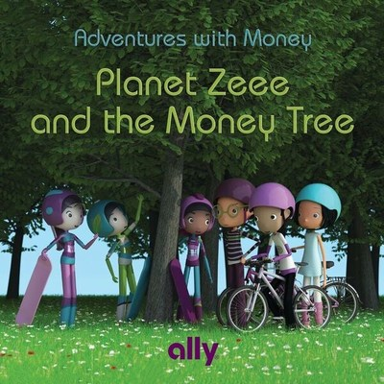
Teaching Kids About the Value of Money
Through the story,
Planet Zeee and the Money Tree

Slide 3
Why are we here and what do we have to share with you?
We are high school students that have a very important lesson to share.
Explain that you are taking a Financial Literacy Course and in it you learn ways to be a better consumer/shopper and a lot of lessons about becoming an adult.
Because you are almost out of high school, it’s very important to learn life lessons.
Share that there are lessons you feel younger students need to know as well.
Take your child on an intergalactic adventure with the kids from Planet Zeee
as they learn important money lessons from their Earthling friends.
It's never too early to teach children financial responsibility and good
money habits.

Slide 4
Presenter 1:
Info about you

Slide 5
Presenter 2:
Info about you

Slide 6
PLANET ZEEE AND THE MONEY TREE -
The book follows the story of three children from another planet who come down to Earth and are confused about how money is earned and used. They meet children from Earth who explain this strange green paper called money and teach them more about how money is earned and why it's important to save and give back.
We will be covering 3 important ideas
Where money comes from.
How to spend wisely.
Importance of saving.
Let’s get to the story...

Slide 7
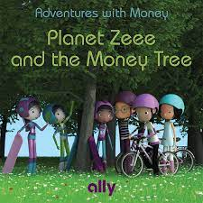
The Story

Slide 8
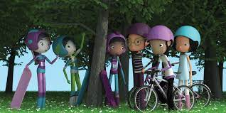
Planet Zee and the Money Tree: GAME

Slide 9
So what did we learn from the story?
Discuss the following ideas with the class:
Where money comes from?
How can we spend our money wisely?
Why is it important to save?

Slide 10
Concluding the Lesson
It’s time for us to head back to the high school, but we would like to thank you for welcoming us into your classroom today. We hope that you have enjoyed the lesson we have presented about making good choices with your money. It is great to be able to buy the things we want, but always remember there are costs or things you must give up. Remember to make good choices with your money and please consider saving some of it for the “big” things you may want or need. It’s easy to spend your money right away, but we hope you will think before you do…Making good choices and SAVING is a great habit to learn.

Slide 11
