Slide 1


Student Names________
School_______________
Class________________

Slide 2
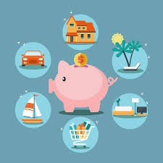
Grade 3 -
SAVING, SPENDING, BORROWING and LENDING

Slide 3
Introduce yourselves. Include your grade and a little bit about you.
Explain that you are taking a financial literacy class and in it you learn ways to be a better consumer/shopper and a lot of lessons about becoming an adult. Because you are almost out of high school, it’s very important to learn life lessons.
There are also lessons that are important for you as elementary students to learn. This can get you a head start to be smart about the choices you make with your money.

Slide 4
Presenter 1:
Info about you

Slide 5
Presenter 2:
Info about you

Slide 6
If You Made A Million…
What would you do if you made a million dollars?
We’re going to hear a story called If You Made a Million. It was written by David M. Schwartz and illustrated by Steven Kellogg. This book describes different ways you can save and spend money.
we will give you a worksheet. Look at the left side of this worksheet. You will see different amounts of money listed. Listen carefully as we read this book. On the line next to each dollar amount, write down the different things you can do with that amount of money. Make sure you write only things that are listed in the story.

Slide 7
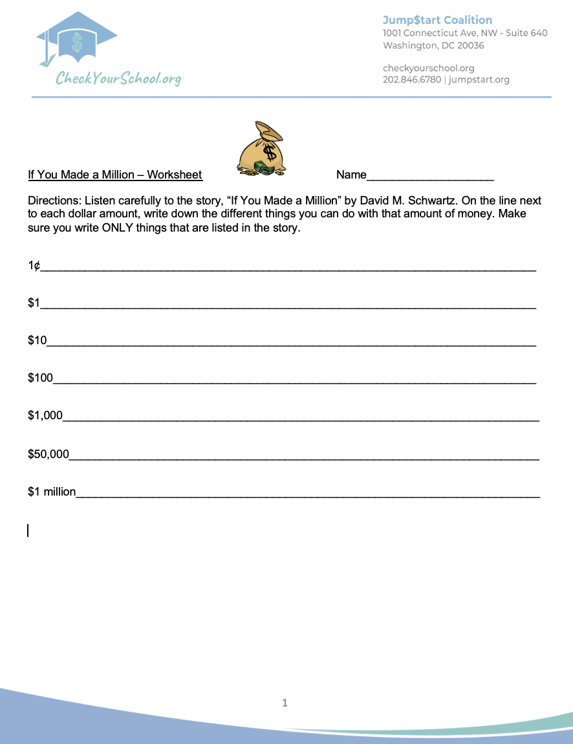

Slide 8

Here’s the Story

Slide 9
Today’s Economic Concepts:
Saving and Spending
When you spend your money, you use it to buy goods. According to the magician in this story, you could use a dollar to buy one hundred pieces of penny candy, or twenty five-cent balloons, or ten stickers for ten cents each, or four rubber balls that cost twenty-five cents a piece. How would you spend a dollar?
Have students respond.
If you don’t spend your money, you can save it. When you save money, you keep some money for the future instead of buying goods or services right now. There are many different ways to save your money. How do you save your money?
Students may say that they save their money in a piggy bank or in a savings account at a bank.
Many people save their money in a savings account at a bank. Do any of you have a savings account at a bank?
Allow students to respond.
Why do you think people save their money in a savings account at a bank rather than in a piggy bank?
Have student share their ideas.
People also save their money in a savings account at a bank because they can earn money. Many banks pay you a certain amount of money for every dollar you have in the bank. This money is called interest. For example, a bank may pay you five cents a year for every dollar you have in the bank.

Slide 10
Today’s Economic Concepts:
Borrowing and Lending
Imagine that you want to buy a new bicycle but you don’t have enough money for it. What can you do?
Let students share their ideas. Students may say that they can earn some money or that they can borrow it.
If you don’t have enough money to buy something you want, you can save your money until you have enough to buy the item, you can earn the money by working, or you can borrow money. Who can people borrow money from?
Students may say you can borrow money from friends and family or from a bank.
You can borrow money from friends and family, or you can get a loan from a bank. When you get a loan, you borrow money and promise to repay the money. You will have to pay back more money than you borrowed because banks charge people interest when they lend people money. This means the bank charges you a certain amount of money for every dollar that you borrow.

Slide 11
Today’s Economic Concepts:
The Role of Banks
Why do people put their money in banks?
Allow students to respond. Students may say people put their money in banks to protect it and to make money by earning interest.
What do you think banks do with the money people put in their banks?
Have students share their ideas.
Banks lend the money that people have put in their banks to customers who want to take out a loan to buy homes or cars, send their children to school, or start a business.
We are going to show you a little role-play about saving and borrowing from your bank.

Slide 12
Savers and Borrowers Script
Saver: Shake hands with the banker and say, “Hello. I would like to put $500.00 in a savings account.”
Banker: “Okay. Let me tell you about our interest rates. We can offer you a two-percent interest rate. This means that every year we will give you two cents for every dollar you have in your savings account.”
Saver: Give the banker $500.00.
Banker: Take the $500.00 and say, “Thank you.”
Borrower: Shake hands with the banker and say, “Hello. I would like to borrow $500.00 to pay for college.”
Banker: Shake hands with the borrower and say, “Okay. Let me tell you about our interest rates. We charge five percent interest on loans. This means that for every dollar you borrow, we will charge you five cents a year. You will have to pay back $500.00 plus the interest.” Give the borrower $500.00.
Notes:
put on seperate piece of paper.

Slide 13
Savers and Borrowers Script (cont.)
Borrower: “I can’t believe one year has passed. I have the money to repay you. Here is the $525.00 I owe you.”
Banker: Take the $525.00 and say, “Thank you.”
Saver: Tell the banker, “I would like to take my money out of my savings account.”
Banker: “Okay. Here is $510.00.”
Notes:
put on seperate piece of paper.

Slide 14
Savers and Borrowers Conclusion
Why does the bank charge more interest for borrowing money than it pays for saving money?
Have students respond.
Banks are businesses that need to make money. To make money, banks charge people more interest for borrowing money than they pay for saving money. In this way, banks make a profit—they make money.When you save, you can make money too if your money is in a bank account.
Maybe you can ask your parents/guardians to take you to a local bank for a tour

Slide 15
Concluding the lesson:
It’s time for us to head back to the high school, but we would like to thank you for welcoming us into your classroom today.
We hope that you have enjoyed the lesson we have presented about saving.
Remember to make good choices with your money and please consider saving some of it for the “big” things you may want or need.
Maybe ask your parents to help you open a savings account at one of our local banks.
It’s easy to spend your money right away, but we hope you will think before you do…SAVING is a great habit to learn.

Slide 16


